Slide 1
11th grade Course Registration

Slide 2
SRVHS Graduation Requirements
Subject Area | Credits
English | 40
Math – must pass Algebra I or equivalent | 20
Social Studies | 35
Science | 20
Physical Education | 20
Health | 5
Breadth – Must complete 10 credits in two of the following three areas: World Languages Visual & Performing Arts Career Technology/ Applied Arts | 20
Electives | 60
TOTAL SRVUSD requirement | 220

Slide 3
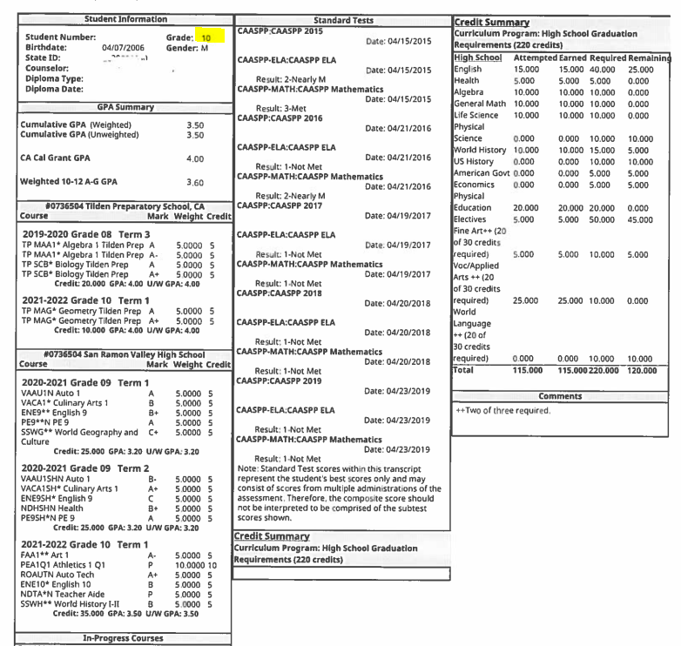
Private & Out of State
At this point you should have 85 of 220 credits
Financial Aid
CSU/UC

Slide 4
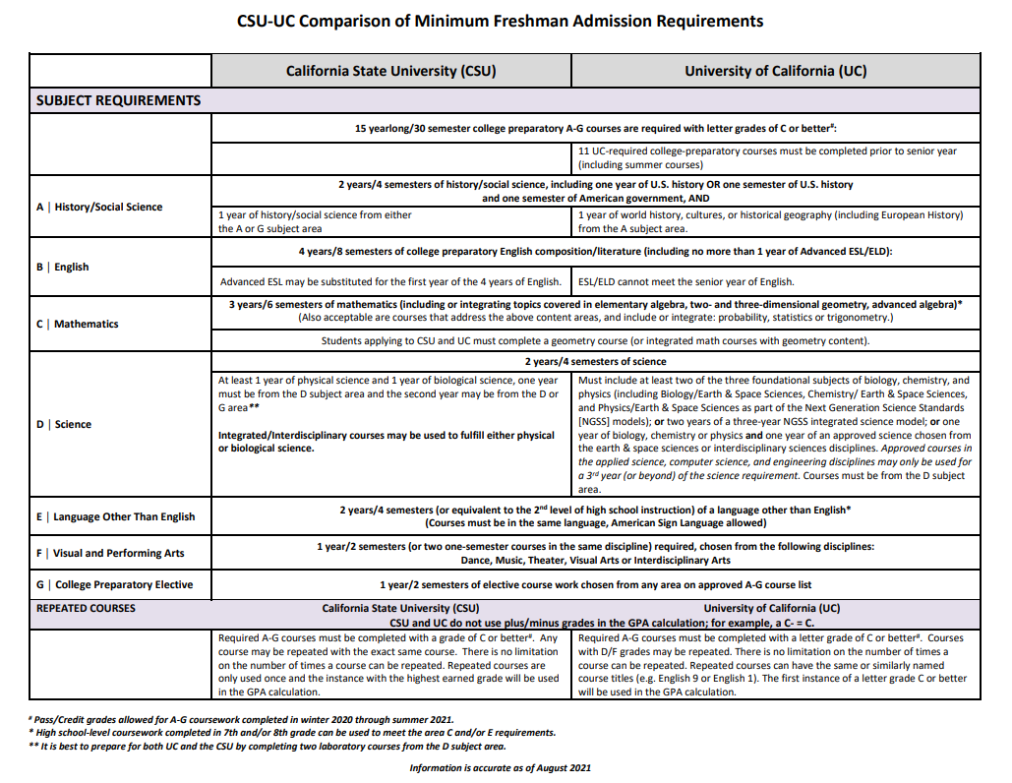
CSU-UC Comparison

Slide 5
Typical Junior Schedule
English 11 or AP Language
U.S. History or AP US History
Math (recommended)
Science (recommended)
World Language/Voc/Fine Arts
Elective
Optional 7th class to make up credits, take extra class, etc.
Students must be enrolled in minimum 5 classes. 6 classes encouraged

Slide 6
FLEXIBLE SCHOOL START AND END TIMES
How: Students will choose from the following schedules
What: Students will have the option of:
Standard School Day
Late-Start School Day
Early-Release Day
Students must be enrolled in a minimum of 5 classes
Students may be enrolled in a maximum of 7 classes (space available/special program)
Periods must be consecutive
Students may not be on campus during an unscheduled period
A full SRV schedule:
1 - 7 (space available)
1 - 6
1 - 5
Late start schedules
2 - 7
2 - 6
3 - 7

Slide 7
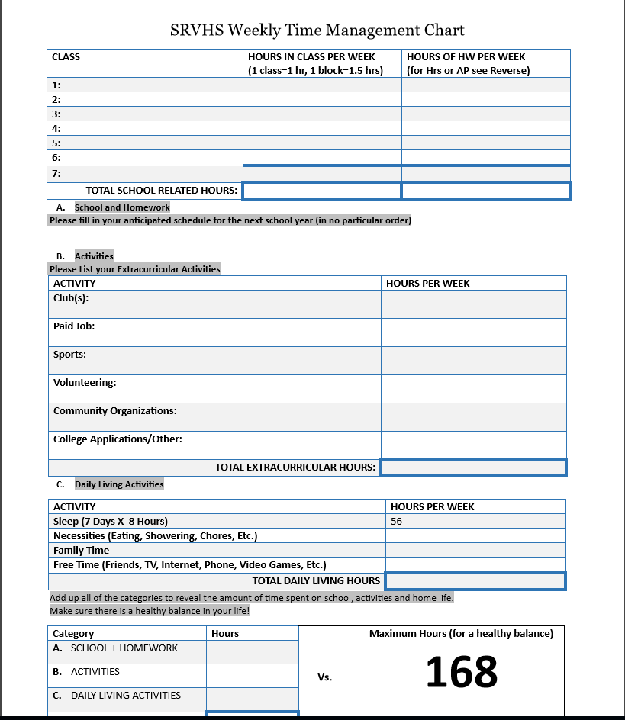

Slide 8
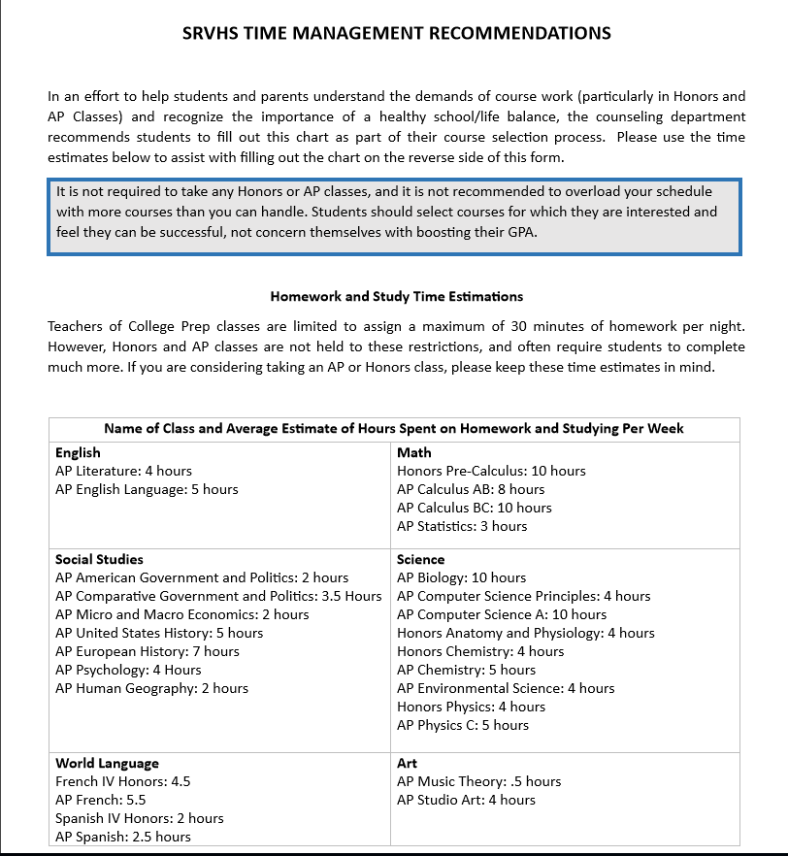

Slide 9
Junior English
English 11
AP English Language
English Elective:
AP Seminar

Slide 10
Mathematics
Algebra I
Geometry
Intro to Data Science
Algebra II
Accelerated Algebra II
Advanced Math Topics
Personal Finance (NCP)
Statistics
Statistics AP
Pre-Calculus/Trig
Pre-Calculus/Trig Honors
Calculus
Calculus AP AB
Calculus AP BC
AP Computer Science A

Slide 11
Junior Social Studies
REQUIRED
US History (year) or
AP US History (year)*
ELECTIVES (Year long) Human Geography AP Interdisciplinary Ethnic Studies Psychology AP | (Semester long) Philosophy Sociology World War II Vietnam Era Note: Sociology paired with Philosophy Vietnam Era paired with WWII

Slide 12
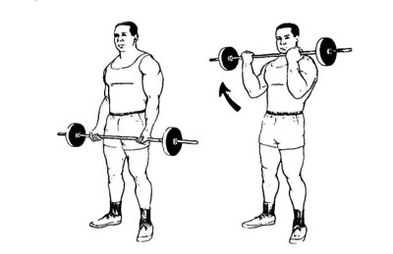
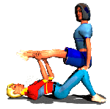
Physical Education
Net Sports
Sports Conditioning
Team Sports
Advanced Weights
Weights
Yoga
Strategies in Recreation
Intro to Dance (year long)
Dance Composition A/B,
Dance company A/B, Dance performance A/B
Dance production A/B by audition only
Marching Band (Semester/ after school)

Slide 13
World Languages
French I
French II
French III
French IV Honors
French Language AP
Spanish I
Spanish II
Spanish III
Spanish IV Honors
Spanish Language AP
** Please refer to course recommendations for appropriate course level selection. **

Slide 14
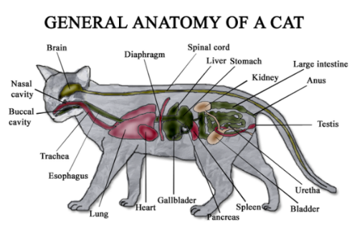
Life Science Electives (Pre-requisite Biology)
AP Biology
Marine Biology
Anatomy/Physiology
Honors Anatomy & Physiology
Forensic Science
Environmental Science AP
Sports Medicine
AP Computer Science Principles

Slide 15
PHYSICAL Science
Chemistry Honors
Chemistry in the Earth
Chemistry AP
Physics of the Universe
Physics Honors
Physics C AP
Environmental Science AP

Slide 16
Visual & Performing Arts
Art 1, Art 2
Art 5 Adv.
AP Studio Art
AP Studio Art 3D
Computer Graphic Arts
Ceramics 1, 3
Digital Photography
Photography, Advanced
Art of Video Production 1, 2
Concert Band
Jazz Band *
Symphonic Band *
Orchestra
AP Music Theory
Marching Band (1st semester, after school)
Intro to Dance
Dance Performance A/B *
Dance Competition A/B *
Dance Production A/B) *
Dance Company A/B *
Vocal Ensemble 1 (Soprano-Alto)
Vocal Ensemble 2 (Tenor-Bass)
Chamber Singers *
Concert Choir *
Treble Choir *
Oral Interpretation
Theatre Arts 1, 2, 3 or 4
Theatre Production
* audition required

Slide 17
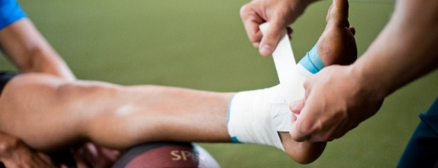
Career Technology/ Applied Arts
Auto 1
Auto Tech
Careers in Teaching 1
Culinary Arts 1
Culinary Arts 2
Intro to Business & Entrepreneurship
Empowering Entrepreneurs
Computer Science C++ (vs.NET)
** Age restrictions may apply for some classes. **

Slide 18
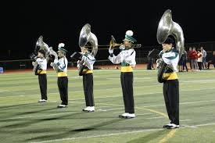
Electives
Publications 1
Advanced Publications 2
Journalism 1
Speech & Debate
Academic Leadership
Work Experience
Sports Med
AP Comp Sci A
AP Comp Sci Principles

Slide 19
Meeting with your counselor
Counselors will be meeting with students 1:1 after online course selection is done
Please hold your questions for your meeting – come prepared to ask
Adjustments can be made during that meeting
*Drop-ins still available during Brunch or Lunch

Slide 20
COMING MARCH 1ST
LUNCHTIME ELECTIVES INFORMATIONAL FAIR

Slide 21
ACCREDITED ONLINE COURSES AND OFF-CAMPUS CLASSES (non-district courses)
What:
Students have the ability to post up to 40 credits of non-SRVUSD coursework on their high school transcripts, including graduation requirements.
Students are limited to 20 credits of outside coursework in one curricular area
A maximum of 20 credits per academic year may be placed onto the SRVUSD transcript
How:
Complete your online course selection as if you are NOT taking an out of district course. Indicate your intent on your schedule and which course you plan to drop
Detailed directions will be on Course Request Instructions

Slide 22
Auditions
Theatre 2, 3 & 4
Auditions – for students new to Theatre will audition in March. Current Theatre students are authorized to move to the next higher level.
Dance 2, 3, 4, 5
Auditions last 4 days: March 28-31 at 3:30 pm
For more details from Mrs. Ward https://srvhs.schoolloop.com/pf4/cms2/view_page?d=x&group_id=1552637628114&vdid=ie33c26od973yu
Symphonic Band
Email bnishida@srvusd.net prior to March 11th if you are in grades 10-12 and want to audition in place of completing the prerequisite of 1 year in Concert Band.
Jazz Band
Email bnishida@srvusd.net prior to March 11th for more info.
Choir -- See Mr. DiGiacinto for dates/info

Slide 23
Upcoming Information Meetings
Electives Fair - March 1st
at lunch in the Quad and Main Gym
Parent Night (VIRTUAL) – Grades (rising) 10-12
February 24th, 6:30 pm via ZOOM
Class information meetings
AP U.S. History, Feb. 17th at lunchtime in B311
Intro to Business & Entrepreneurship. AND Empowering Entrepreneurs, Feb. 23rd at lunchtime in A202
Publications (Yearbook), Feb. 24th at lunchtime in D102
AP Human Geography, Feb. 28th at lunchtime (B313)
Culinary 1, 2 Mar. 2nd at lunchtime in B110
AP Lang, March 3rd at lunch in Library
Careers in Teaching, Mar. 8th at lunchtime in A202
Work Experience, Mar. 10th at lunchtime in A202

Slide 24
Important Course Selection Dates
Course selection instructions and course lists will be distributed in Access on March 2nd
Online Course Selection IC window
March 4-13

Slide 25
Winter/Spring Dates
DVC Workforce Development Dept. – Feb. 17^{th,} SRV Commons 10:50 – 11:30 am
DVC Outreach/Welcome Services – Mar. 10^{th ,} SRV Commons 10:50 – 11:30 am
Town of Danville Teen Summer Job & Volunteer Fair – Apr. 21, Time & Location TBD
SRV Career Fair – Apr. 14th, B Bldg. classrooms, time TBD
Vocational Fair – Apr. 14th, 4:00 – 6:00 pm, Commons
SRV College Application Virtual Workshop for Junior Parents – May 17th @6:30 pm
Summer school for remediation (SRVUSD) – TBA
Summer advancement via outside institution – District link

Slide 26
College and Career Center
College and Career Center (B102) available for additional information regarding summer programs, college inquiry, and post graduation planning
Email Questions to Mr. Ordonez at nordonez@srvusd.net
Visit the College and Career Page https://srvhs.schoolloop.com/ccc

Slide 27
SAT/ACT
These tests are optional/not required at some colleges.
SAT and SAT Subject tests
Register at www.collegeboard.com
ACT- Register at www.act.org

Slide 28
THANK YOU

