Slide 1
Welcome Freshman!
Class of 2027
San Ramon Valley High School
Welcome to the Wolf Pack
Notes:
1

Slide 2
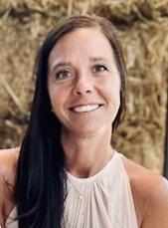
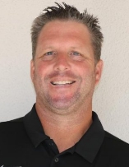
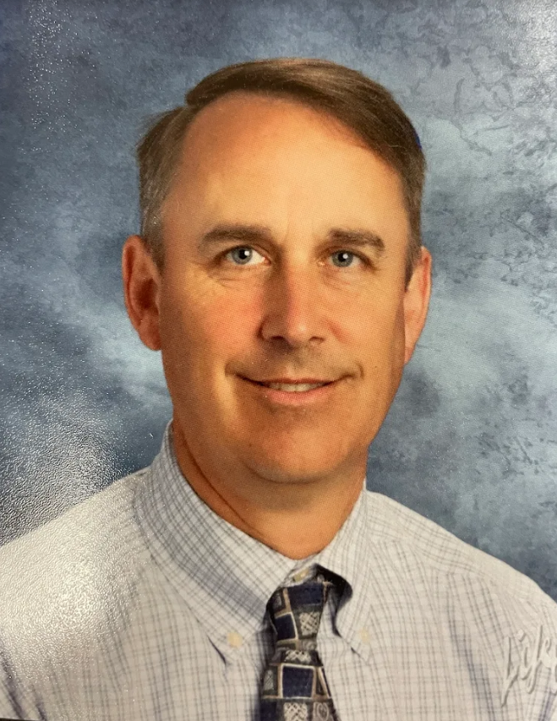
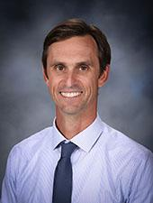
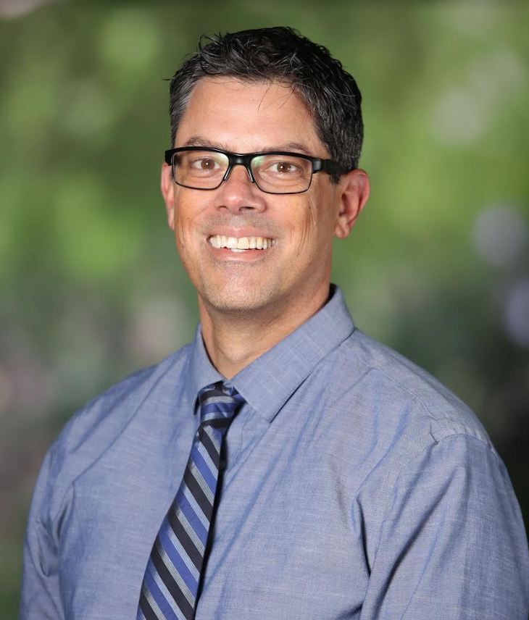
SRVHS Administrative Team
Ms. Whitney Cottrell
Principal
Mr. Chris DeClercq
Athletic Director
Mr. Craig Bocks (A-G)
Assistant Principal
Mr. Charlie Litten (H-N) Assistant Principal
Mr. Dave Miller (O-Z)
Assistant Principal

Slide 3
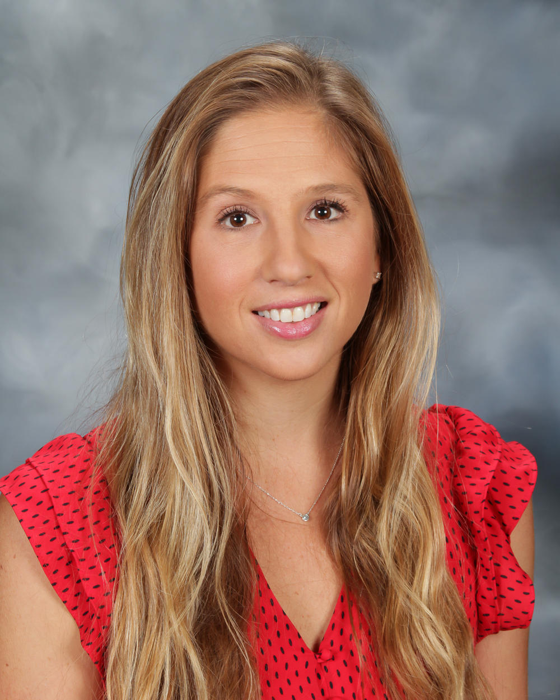
Wolves Counselors 2022-2023
Rebecca Wiest A-Deu
rwiest@srvusd.net
Nancy Conti Dev-Joh
nconti@srvusd.net
Palma Dell Jon-New
pdell@srvusd.net
Melissa Bergstedt Nex-Sh
mbergstedt@srvusd.net
Kirsten Drake Si-Z
kdrake@srvusd.net
Connie Iglesias Student Support
ciglesias@srvusd.net

Slide 4
Wolves Counseling
6 Counselors
Support for struggling students
Academics
Health issues
Social & Emotional
Student drop-in/sign up
Student Support/Lunch
Communicate with teachers
Appointments or email
Current and post-secondary planning meetings
Student/Parent Information Nights
College Applications
Naviance - College & Career Planning Software
Individual & Group meetings
Personal/Academic

Slide 5
College and Career Center
Nemesio Ordoñez – nordonez@srvusd.net
Career & College Information
Volunteer Information
College Rep Visits
Test Prep Information
Financial Aid Information
Scholarship Information
Mr. Ordoñez meets with 10th-12th graders for post high school planning

Slide 6
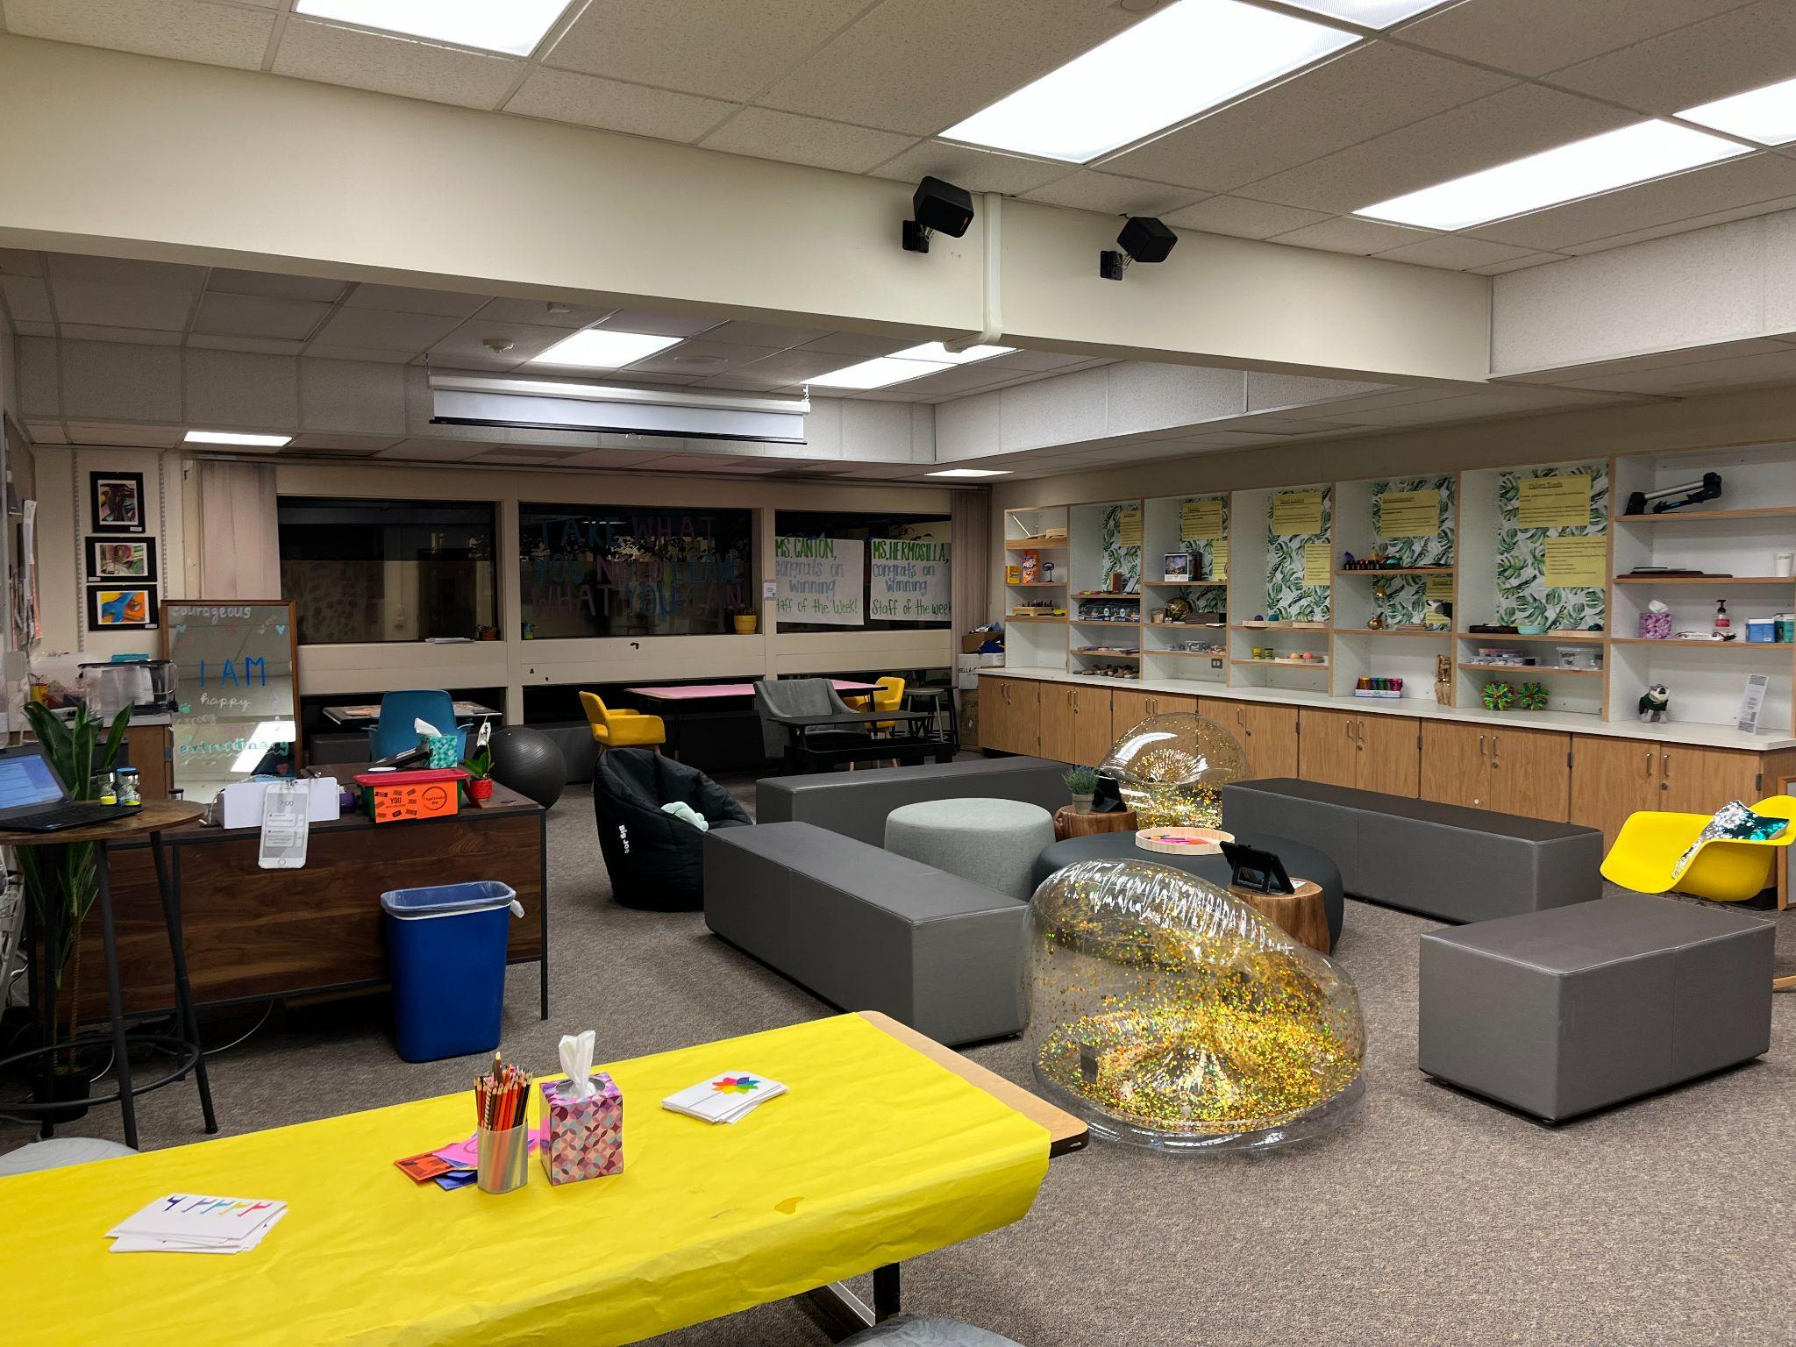
Calming Space: Take a break, decompress, regroup
Connect with Peers: Lunchtime activities, Wellness Wednesdays
Learn Skills & Tools: student workshops
Located through the Attendance Office
SRVHS Wellness Center
Lacy Canton, Wellness Center Social Worker

Slide 7
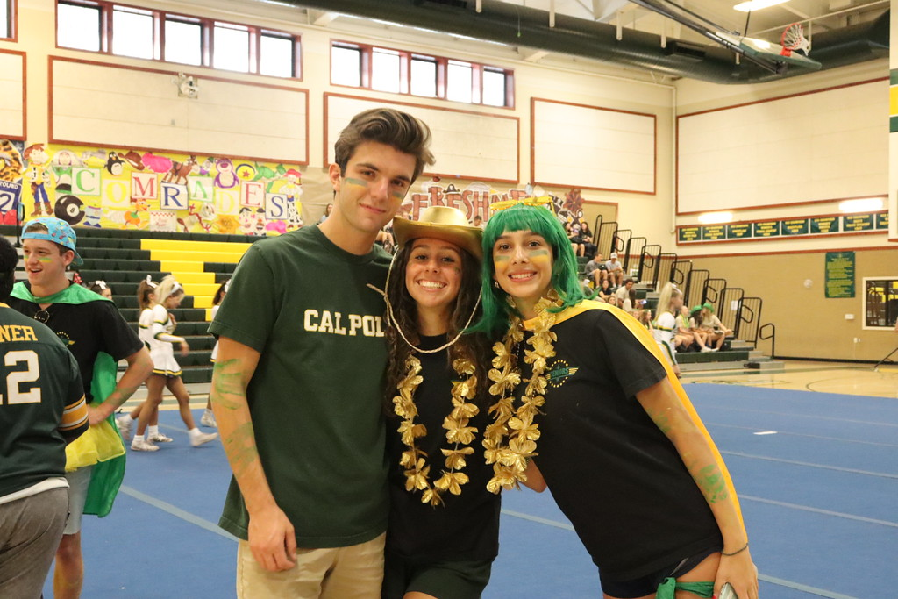
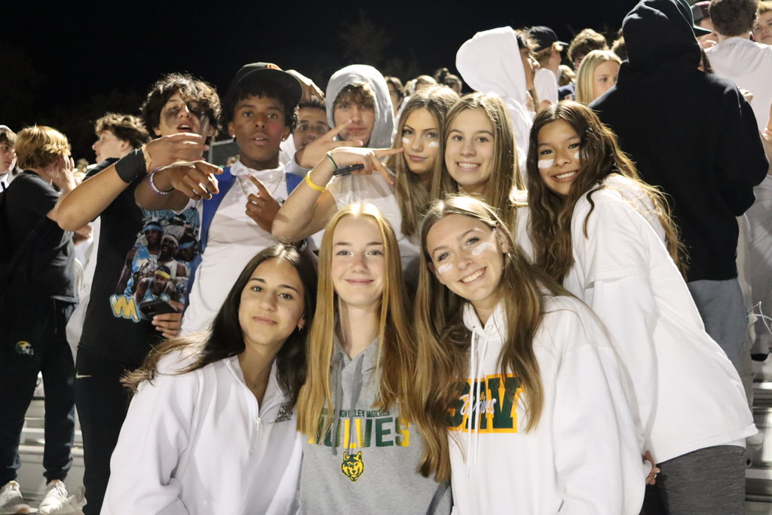
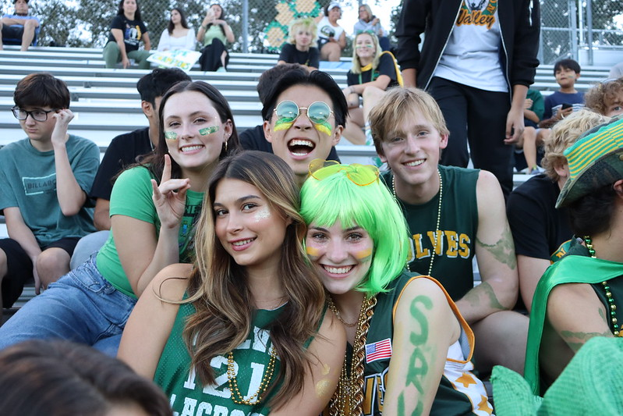
Get Involved at SRV!
Meet new friends
Make connections with staff and students
Have fun while in high school
Improve study habits
Improve time management skills
Maintain higher grades
Improve school attendance
Ways to get involved: Join Clubs,
Band, Drama, Choir, Leadership,
Speech & Debate, Athletics.

Slide 8
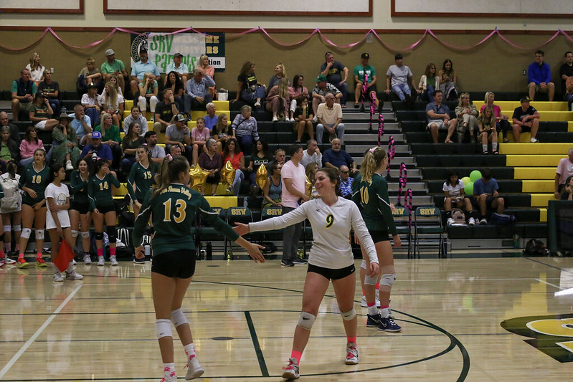
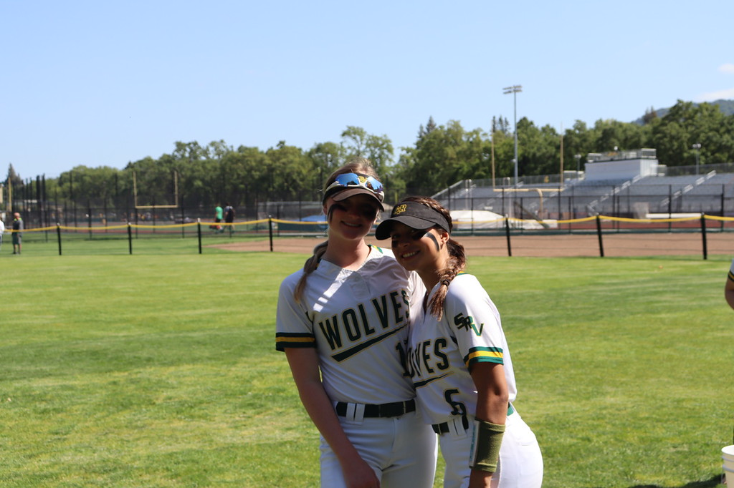
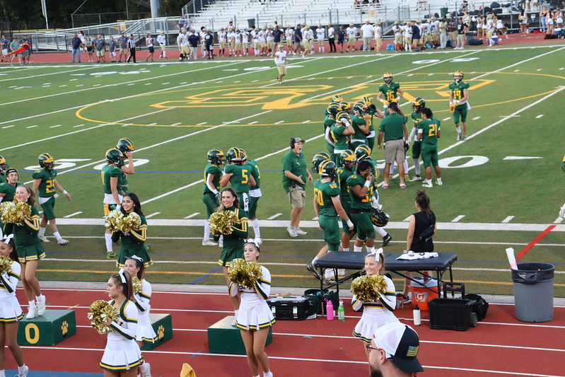
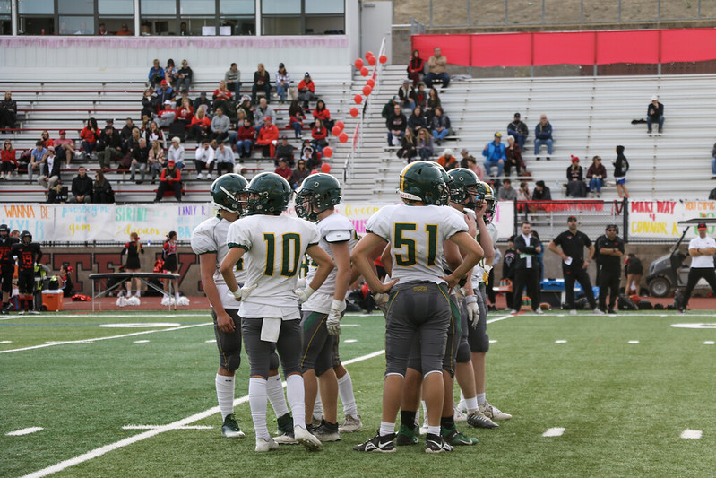
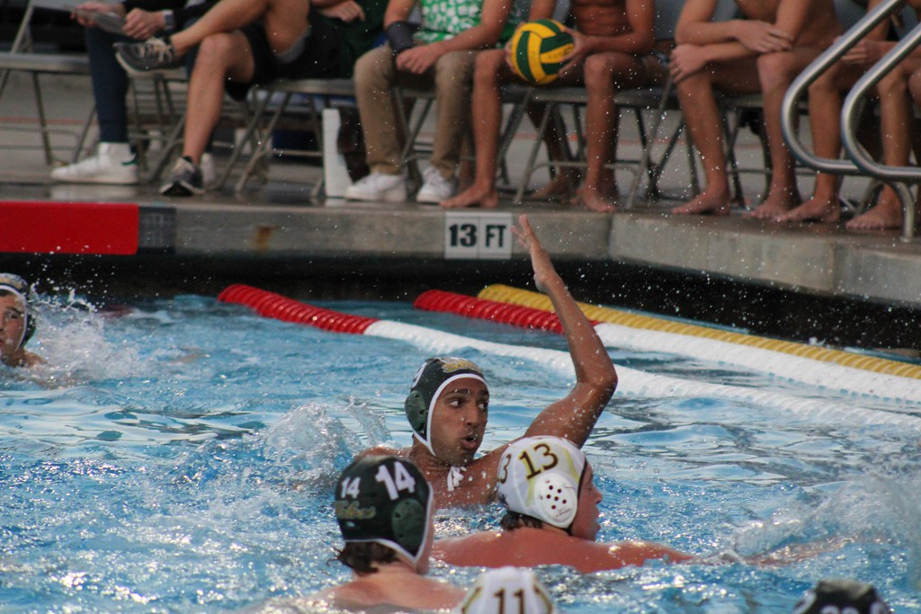
Athletics – Must have 2.0 GPA in previous semester or quarter to participate.
Fall Sports | Winter Sports | Spring Sports
Cross Country* | Basketball | Baseball
Football | Soccer | Boys Golf
Girls Tennis | Wrestling* | Lacrosse
Girls Volleyball |  | Softball
Girls Golf |  | Swimming/Diving
Water Polo |  | Boys Tennis
 |  | Track & Field *
* = No Cut Sport |  | Boys Volleyball
 |  | Badminton

Slide 9
SRVUSD Graduation Subject Requirements
Subjects | SRVUSD-High School Requirements
English | 4 Years (40 CREDITS)
Math | 2 Years (20 Credits) (10 credits must be earned in Algebra 1 or Algebra 1 Enriched 2)
Social Studies | (35 Credits) World Geography World History US History American Government/Economics
Science | 2 Years (20 Credits) 1 Year Life Science 1 Year Physical Science

Slide 10
Graduation Subject Requirements
Subjects | SRVUSD-High School Requirements
World Language* | 10 credits required from two separate fields
Fine Arts* | 10 credits required from two separate fields
Voc Applied Arts* | 10 credits required from two separate fields
Health | 5 Credits
Physical Education | 2 yrs (20 credits)
Electives | 60 Credits
Total | 220 Credits

Slide 11
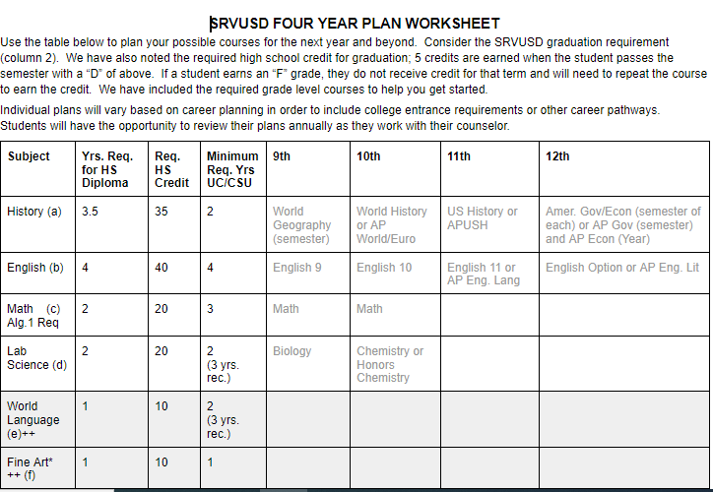
4 Year Course Planning

Slide 12
Personalized Learning Options (PLIs) or Non-District Courses
Personalized Learning Options are intended to provide flexibility for students & families, increase overall student wellness, and ultimately improve working conditions for staff by lowering class sizes.
These options have been refined based on feedback from students, parents, staff and board members over the past few years.
For more information, please visit the Personalized Learning section on our district homepage: http://www.srvusd.net/personalizedlearning

Slide 13
Personalized Learning
Graduation Credit for Online, Off-Campus and College Courses
SRVUSD will provide credit towards graduation for completion of accredited online courses, off-campus courses and college courses. A total of 40 credits from non-district courses may be included on the official SRVUSD transcript and used towards meeting graduation requirements.
Current 8th graders cannot complete a course prior to the last day of school (June 2nd, 2022) if the course is going to be added to the high school transcript.
*Reminder: This is not required! Please know students will have plenty of opportunities to complete the requirements at SRVHS and for college admissions. Keep in mind extra-curricular activities and other responsibilities.

Slide 14
Personalized Learning Continued…
Independent Study PE
SRVUSD will provide flexible PE credits for
Independent Study PE (must apply on the district website and qualify, all grades eligible). Please visit the district site for more information
Marching Band PE (10th-12th grade)-5 credits per season
Athletic PE (10th-12th grade)-10 credits per season * with submission of Athletic PE Form to Athletic Director

Slide 15
Bell Schedule for 2023-24
Per California Senate Bill 328, high schools cannot start before 8:30am.
San Ramon will still offer 7 periods with school starting at 8:30am ending at 3:20pm.
Most 9th graders choose 1-6 periods.
Please note, that a 7 period day is NOT guaranteed as we have very limited B period classes.

Slide 16
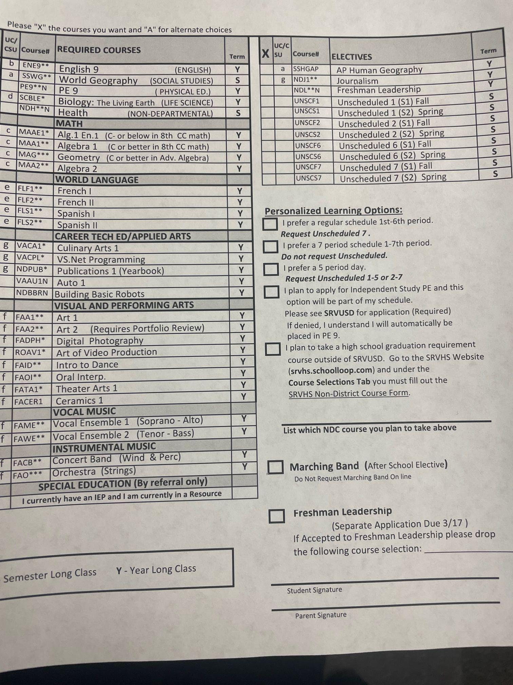
9TH grade Course Selection

Slide 17
9th Grade Schedules
We recommend that all 9th grade students enroll in at least 6 classes.
Students can request 7 classes on a space available basis as we have limited B period classes
Required Courses:
English 9 (will be assigned to all 9th graders)
PE 9 (will be assigned to all 9th graders)
World Geography/Health (will be assigned to all 9th graders)
Science
Biology: The Living Earth (will be assigned to all 9th graders)
Math (Students select the appropriate class)
Algebra 1 if C or better in 8th Course 3 Math (our recommendation is B or better)
Geometry if C or better in Algebra 1 (our recommendation is B or better)
Algebra 1 Enriched 1 (A1E1) if C- or below in 8th Course 3 Math
Algebra 2 (C or better in Geometry)
World Language
French, Spanish
Electives: Visual & Performing Arts and Career Tech Ed (Vocational Applied Arts)
Special Education – for students with an IEP (see your 8th grade Case Manager)
Please review Course Catalog on the Counseling website.

Slide 18
9th Grade Course Selection
Current SRVUSD students:
Complete Online Course Selection February 27th to March 10th
See instructions, visit counseling website for additional information.
Meet one on one with SRVHS counselor -March 10th (Stone Valley) -March 9th (Charlotte Wood)
Balance is essential

Slide 19
Incoming Students Who Are New to SRVUSD
Please contact Kathleen O’Grady, Registrar- kogrady@srvusd.net or visit the website for more information.
SRVUSD registration information on district website (www.srvusd.net)
Kathleen will provide families with 9th Grade Course Selection Form as you will not have access to the online course selection portal (since your registration is not complete). Please electronically return your form to Ms. O’Grady. (Please note: you don’t need to adhere to the timeframe provided for the online course selection portal).
If your child has a 504/IEP, provide documentation with registration materials
Your SRVHS Counselor will then be in contact with your family.

Slide 20
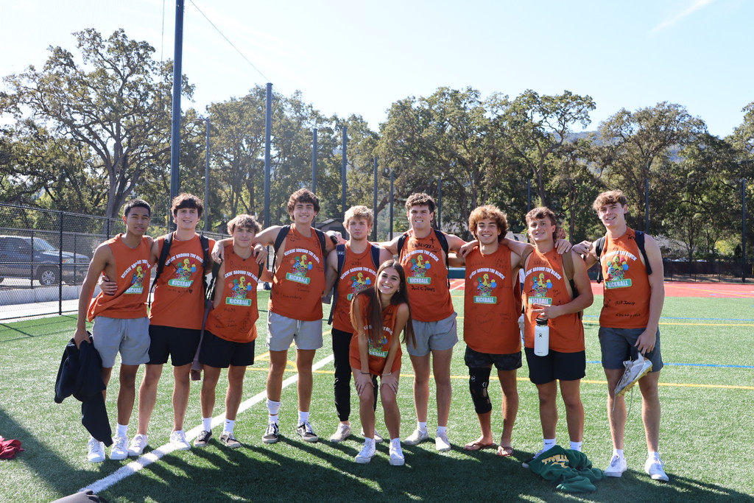
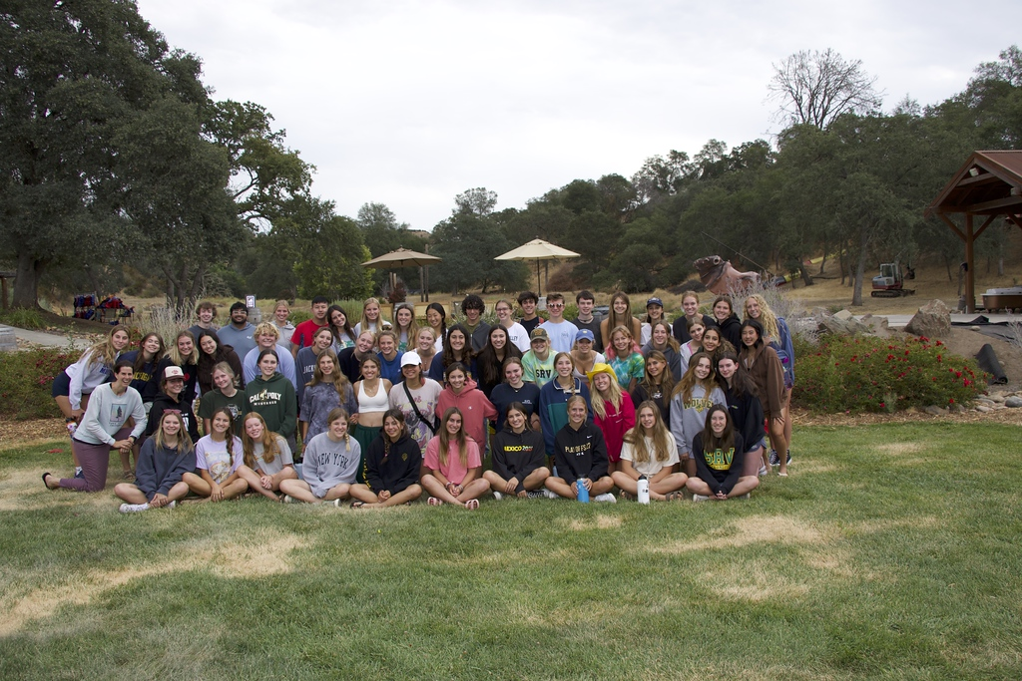
Strategies for Success
Student Planner/Planner App
Student/Parent Handbook
Establish a Study Schedule
Talk with your Teachers, Counselor, Coach
Do Homework…to learn it….not to complete it!
Take time to unplug yourself
Attendance
Utilize Student Support Period
Time Management
Social Transition – Get involved!
Schoology/Google To Do List

Slide 21
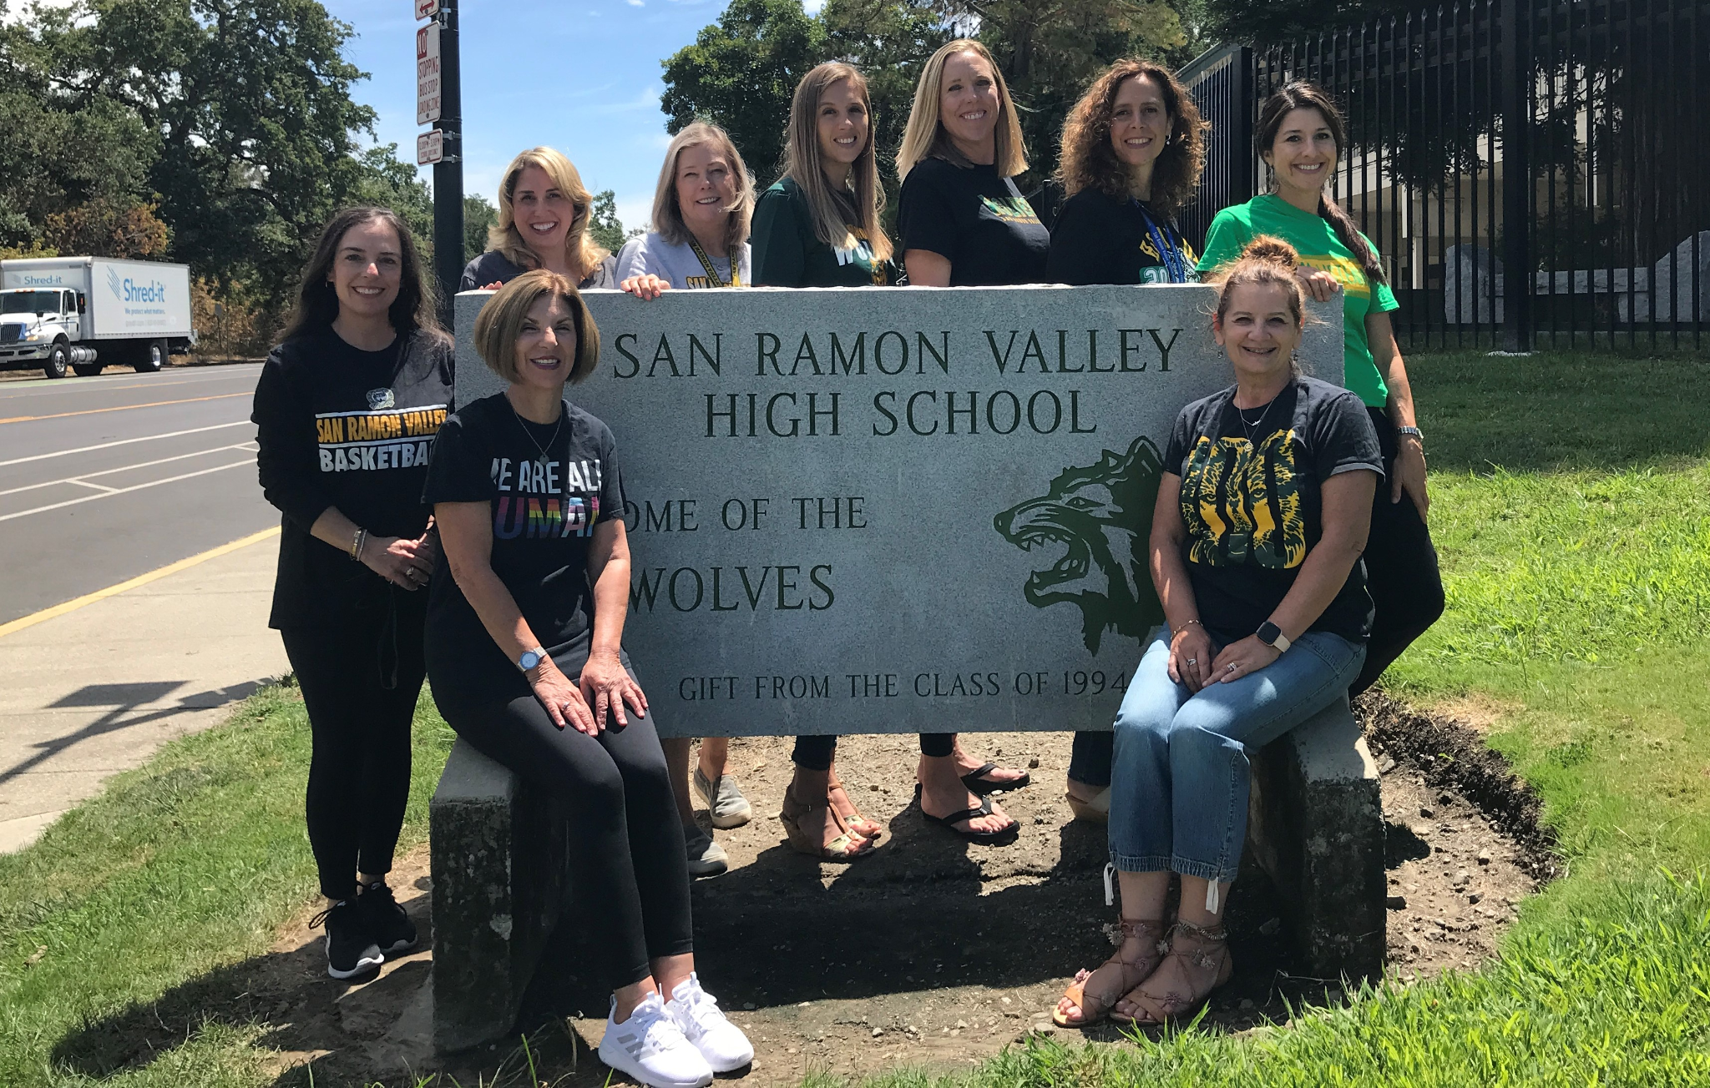
Get ready to join the
Wolf Pack!

